Slide 1
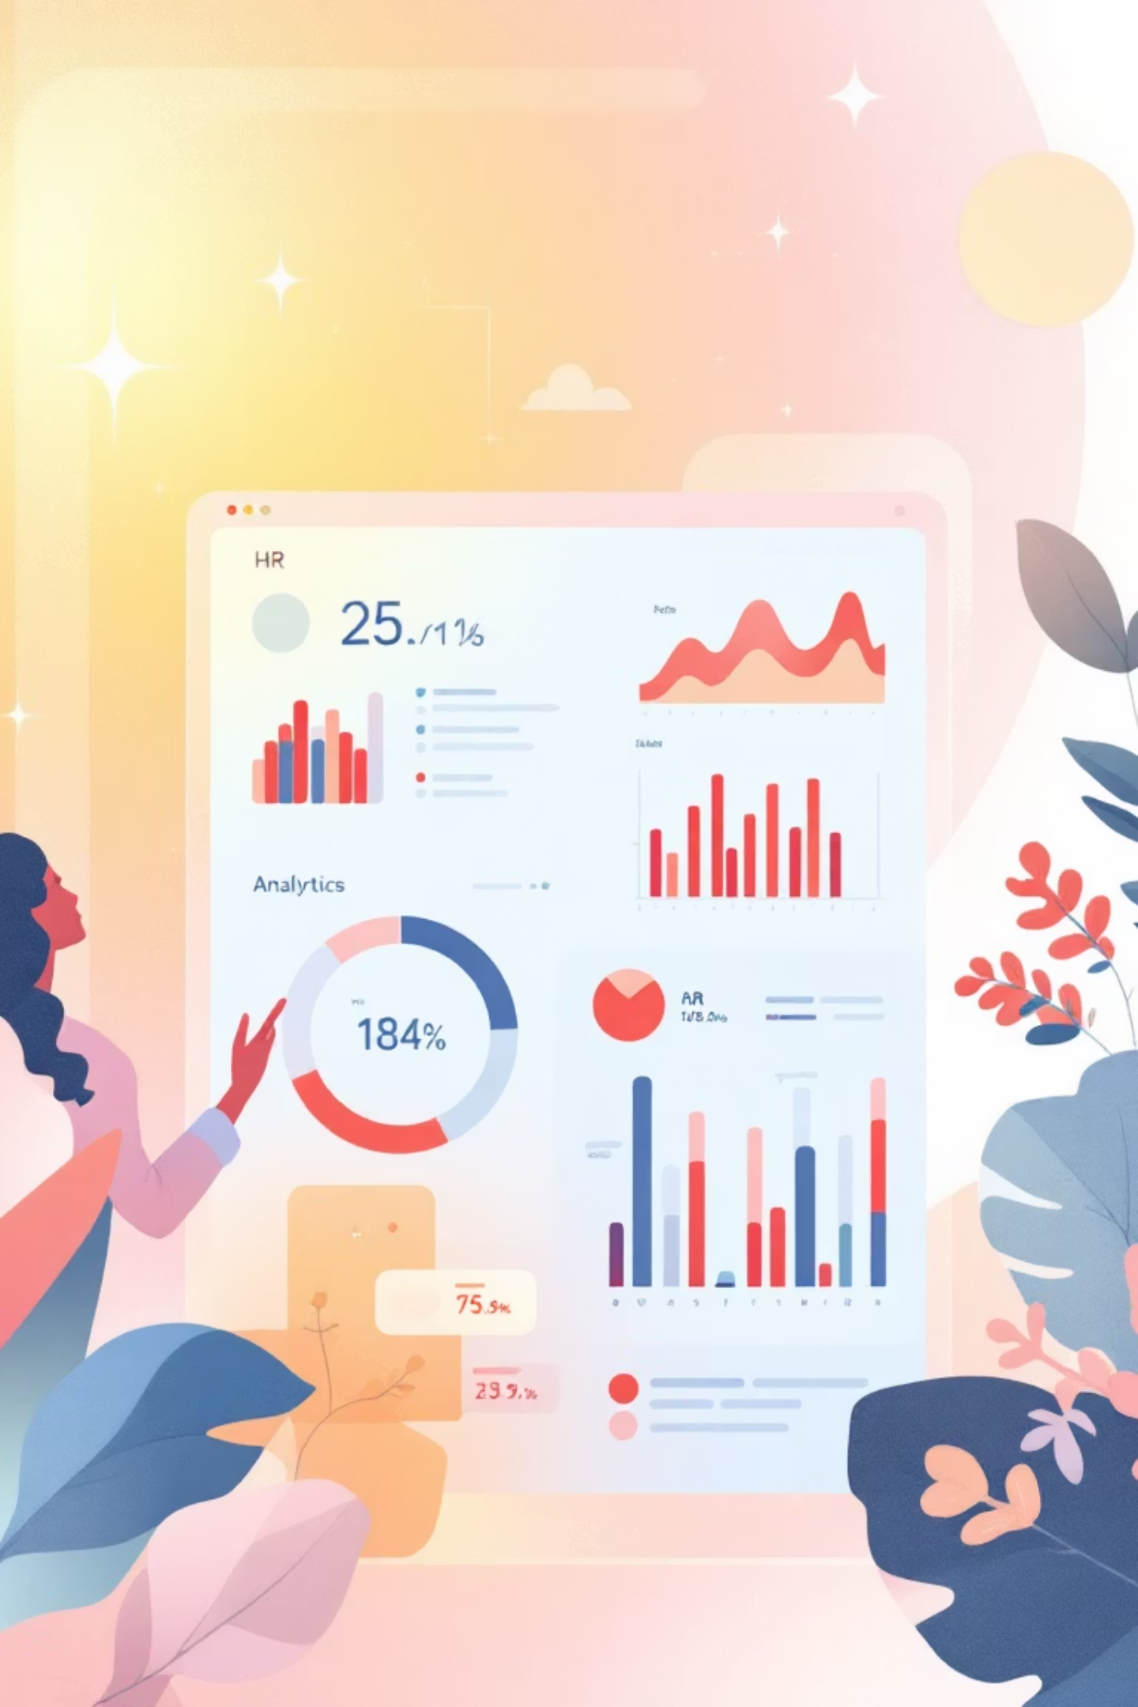
ASK HR
An AI-Powered HR Analytics & Assistant Platform
Development Team
Muhammad Suffian Tafoor - Lead Developer
Ahmed Asad Butt - AI Specialist
Asad Mahmood - junior designer
Iftikhar Ahmed - junior designer
Mubariz Malik - junior designer

Slide 2
Revolutionizing HR Management with AI
Transform your HR operations with intelligent data management, contextual AI responses, and real-time workforce analytics.

Slide 3

The HR Data Challenge
Current Pain Points
Traditional systems lack intelligent search capabilities
No contextual analysis or real-time insights
Manual processes slow down decision-making
Disconnected data sources create inefficiencies
AI Integration
Advanced artificial intelligence for smarter HR management
Interactive Dashboards
Intuitive interfaces making complex data accessible
Data Analytics
Real-time insights driving strategic workforce decisions

Slide 4

Core AI Capabilities
Retrieval-Augmented Generation (RAG)
Delivers intelligent, context-aware answers by combining AI reasoning with your organization's specific HR data and policies.
Semantic Search
Powered by sentence transformers, our system understands the meaning behind queries for more accurate and relevant results.
Contextual HR Responses
AI comprehends complex HR scenarios, policies, and relationships to provide nuanced, actionable guidance.
Natural Language Processing
Employees and managers can ask questions in plain English, eliminating the need for technical query languages or complex interfaces.

Slide 5

Advanced Data Management
01
02
Real-Time Data Fetching
Automatic Embedding Generation
Seamless integration with Supabase ensures your HR data is always current and accessible for immediate analysis.
System automatically processes and structures data for optimal AI understanding and retrieval performance.
03
Comprehensive Data Handling
Manages organization structures, employee profiles, attendance tracking, and leave management with precision.

Slide 6

Interactive Chat Interface
Modern Chat UI
Intuitive conversation history and seamless user experience designed for both technical and non-technical users.
Real-Time AI Responses
Instant, intelligent answers powered by advanced language models, reducing wait times and improving productivity.
FAQ & Contextual Conversations
Handles routine inquiries automatically while maintaining context for complex, multi-part discussions.
Universal User-Friendly Design
Accessible interface that empowers both HR professionals and employees to get answers quickly and efficiently.

Slide 7
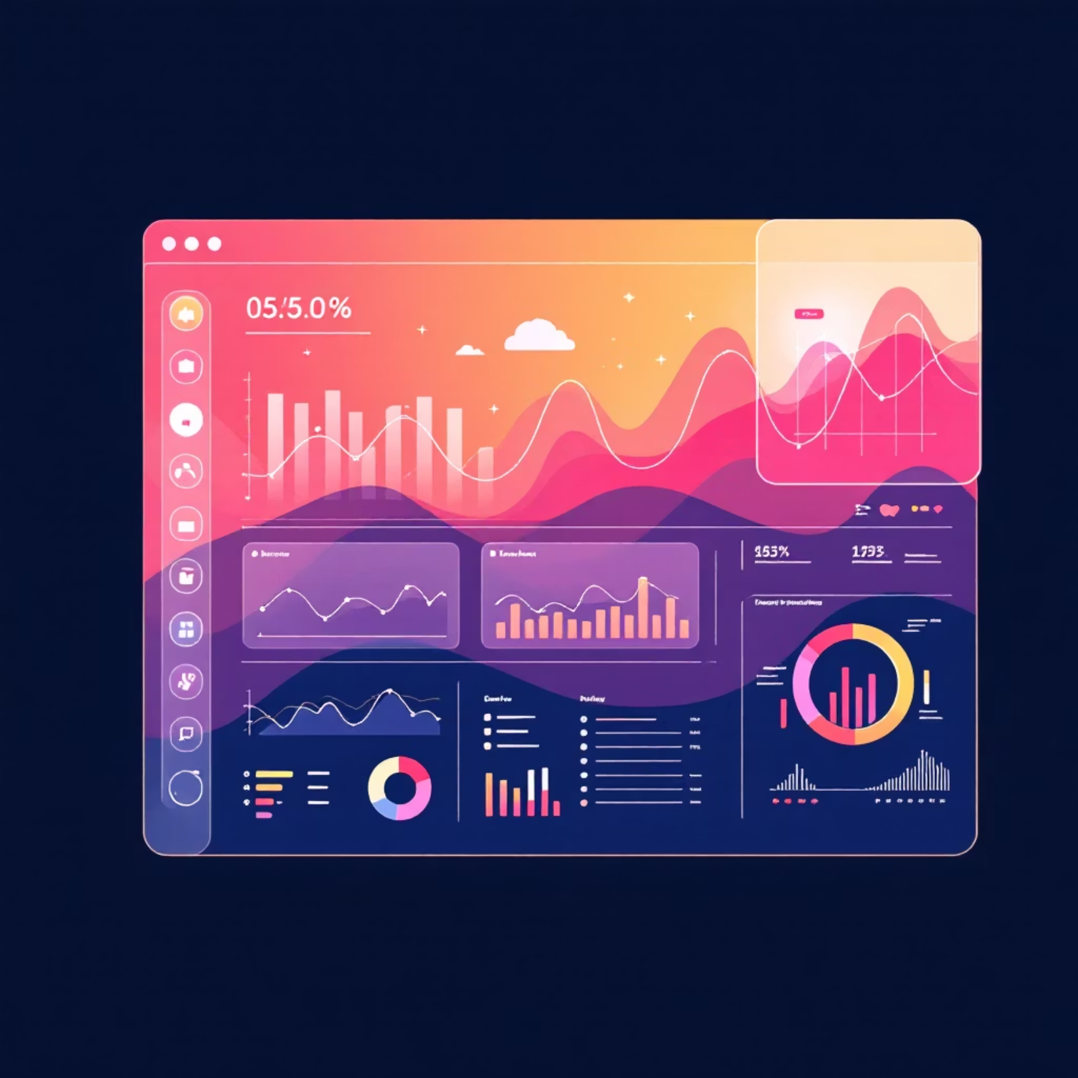
Analytics & Insights Dashboard
Transform Data Into Strategic Advantage
Our comprehensive analytics suite provides deep insights into workforce patterns, performance metrics, and organizational health indicators.
Employee engagement and productivity metrics
Role distribution and organizational structure analysis
Predictive analytics for workforce planning
Interactive visualizations for data exploration
45%
78%
3x
Faster Decisions
Query Accuracy
Productivity Boost
Reduction in time needed for HR data analysis and reporting
Improvement in finding relevant employee and organizational information
Increase in HR team efficiency with automated insights

Slide 8
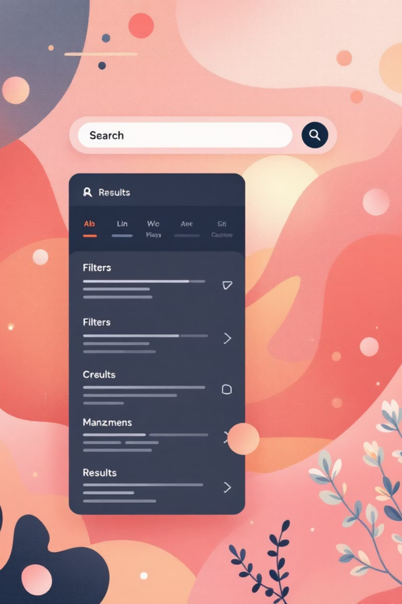



Advanced Search & Query Engine
Employee Search
Comprehensive employee and organization search with intelligent matching algorithms
Role-Based Filtering
Advanced filtering and query capabilities based on roles, departments, and custom criteria
Quick Lookup
Instant access to contact information, attendance records, and leave status across the organization

Slide 9




Technical Architecture
Groq API Integration
FAISS Vector Store
Lightning-fast AI inference capabilities delivering sub-second response times for complex HR queries and analysis.
Efficient semantic search infrastructure enabling precise document retrieval and contextual understanding at scale.
Streamlit Interface
Secure Database
Responsive, modern web interface that adapts seamlessly across devices while maintaining professional aesthetics.
Enterprise-grade security with Supabase integration ensuring data protection and compliance with privacy regulations.

Slide 10








Comprehensive Dashboard Features
Employee Statistics
Organization Tracking
Comprehensive overview of workforce demographics, performance indicators, and engagement levels
Real-time monitoring of organizational growth, structure changes, and departmental metrics
Leave Management
Attendance Monitoring
Streamlined leave request processing, balance tracking, and policy compliance monitoring system
Advanced tracking of attendance patterns, punctuality trends, and workforce availability analytics

Slide 11





Transformational Benefits
The Future of HR is Here
Our next-generation HR assistant combines artificial intelligence, advanced analytics, and intelligent automation to transform how organizations manage their most asset—their people.
For Organizations
Data-driven insights enable smarter strategic decisions and improved workforce planning capabilities
For Employees
Self-service access to personal data, leave balances, and attendance records enhances employee experience
For HR Teams
Automated queries and instant analytics save valuable time while improving accuracy and compliance
For Management
Real-time workforce performance visualization supports informed leadership and strategic planning decisions
"Scalable, secure, and ready to integrate—empowering organizations to become more efficient, data-driven, and future-ready."

Slide 12
Conclusion
AI-Powered HR Transformation: Our project brings intelligence to HR, enabling smarter decision-making.
Efficiency & Automation: Reduces manual workload with real-time insights and automated responses.
Data-Driven Decisions: Analytics & visualizations empower organizations to optimize workforce performance.
Scalable & Future-Ready: Built with modern tools (Groq, Supabase, FAISS, Streamlit) to handle future growth.
Value for All Stakeholders: HR, employees, and management all benefit from improved accessibility and insights.

